Slide 1
L4/5 Group 4
Ripple Footie
Connor Wilby
Sam Clack
Henry Smith
Heather Bishop

Slide 2
The Current Iteration

Slide 3
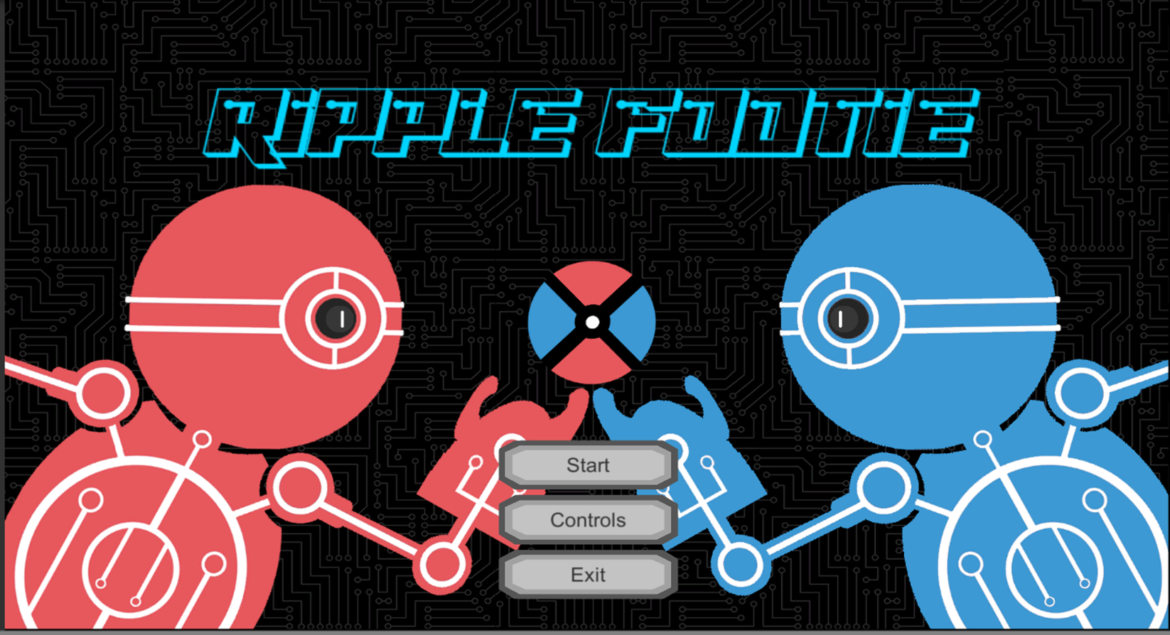
Currently Implemented

Slide 4
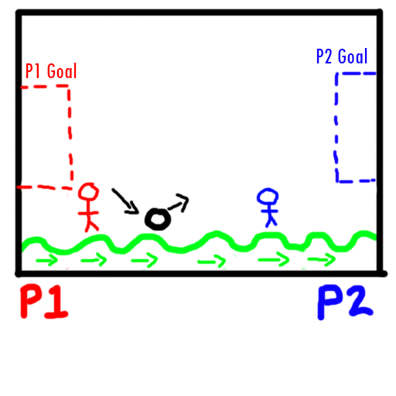
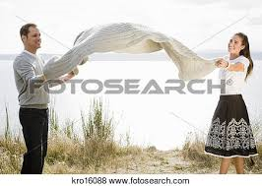
From Humble Beginnings

Slide 5
The Game Loop
Hit Ball
Score Goal
Reward

Slide 6
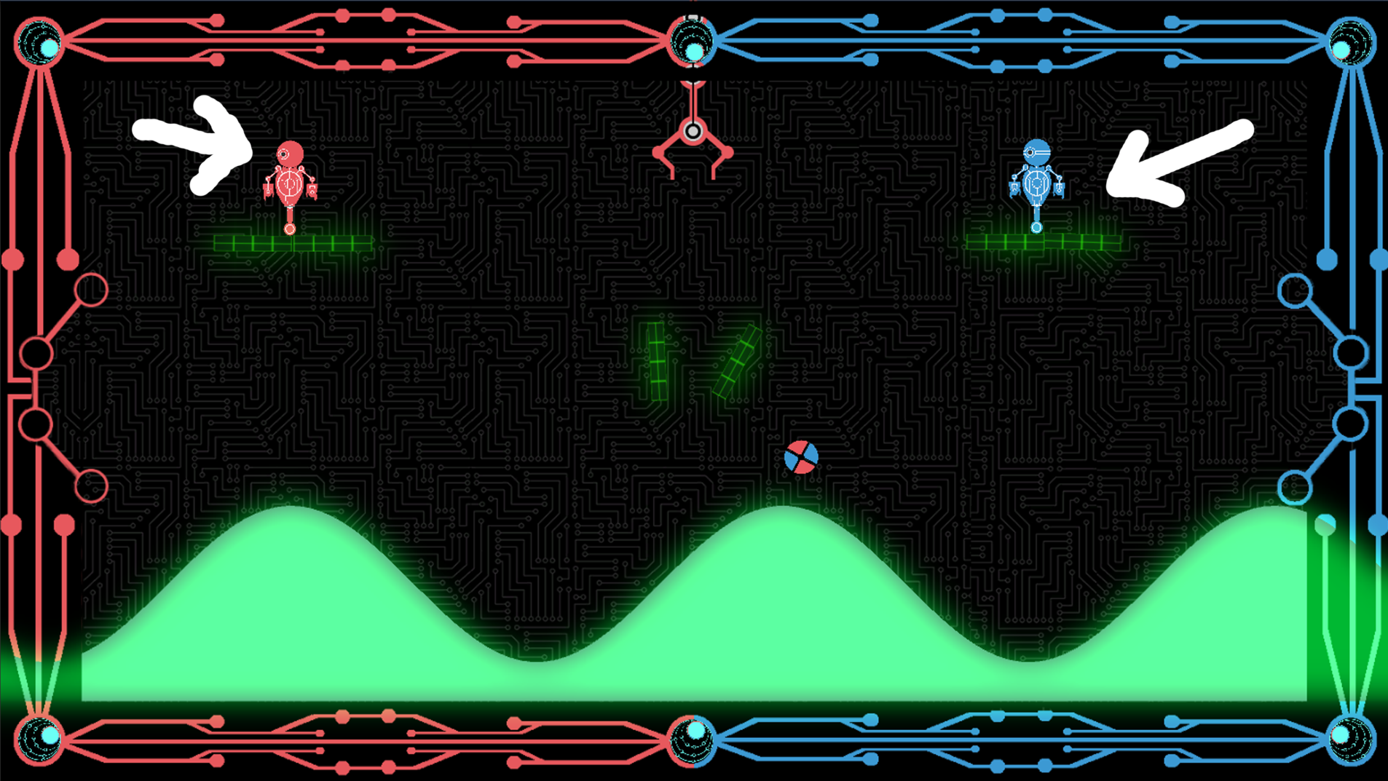
Keep It Fair
Gameplay is symmetric/simultaneous.

Slide 7

Chance vs Skill
Unpredictability of the wave and jump.
Skill of timing ball hits and judging angles and distances of bounces.
Respite to regroup with platforms.
Judging best moment to use kick mechanic.

Slide 8
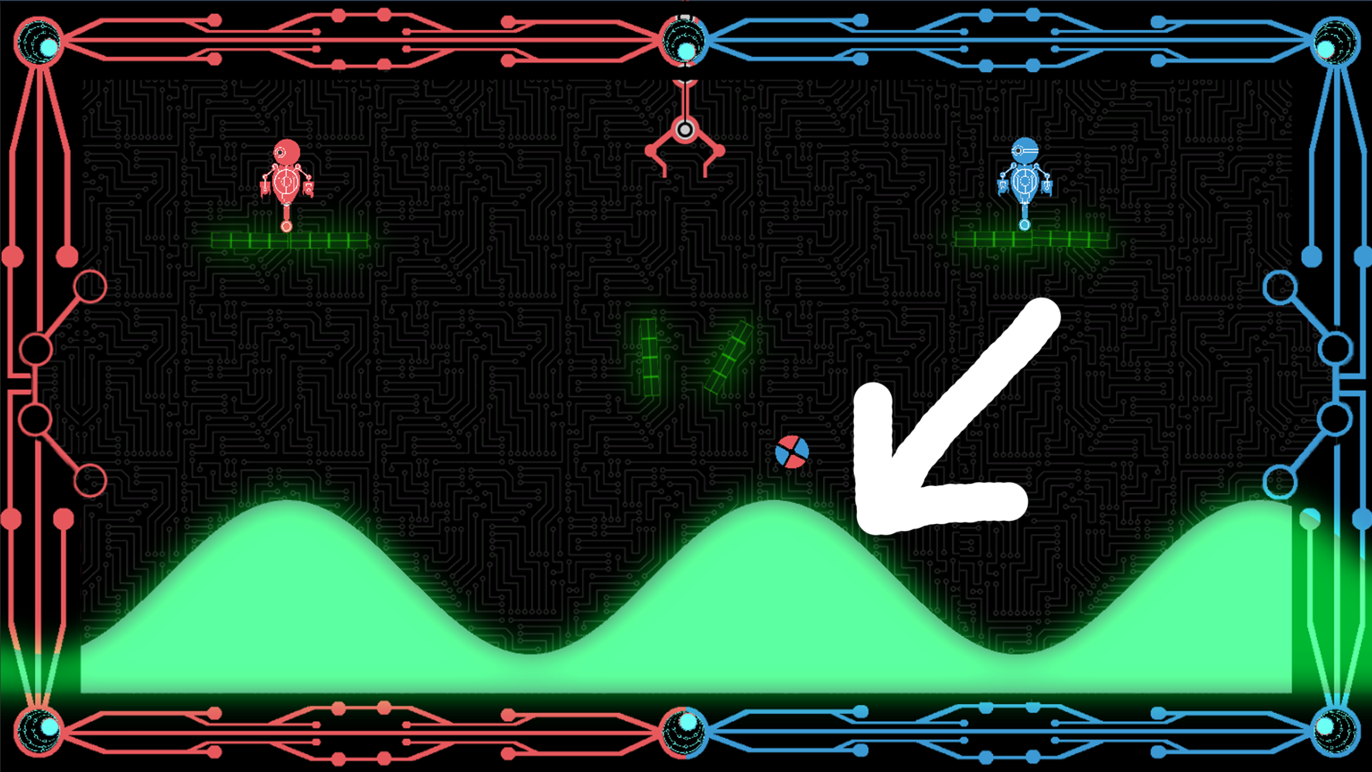
What Challenge?
Physics generated by the terrain mimicking a wave.

Slide 9
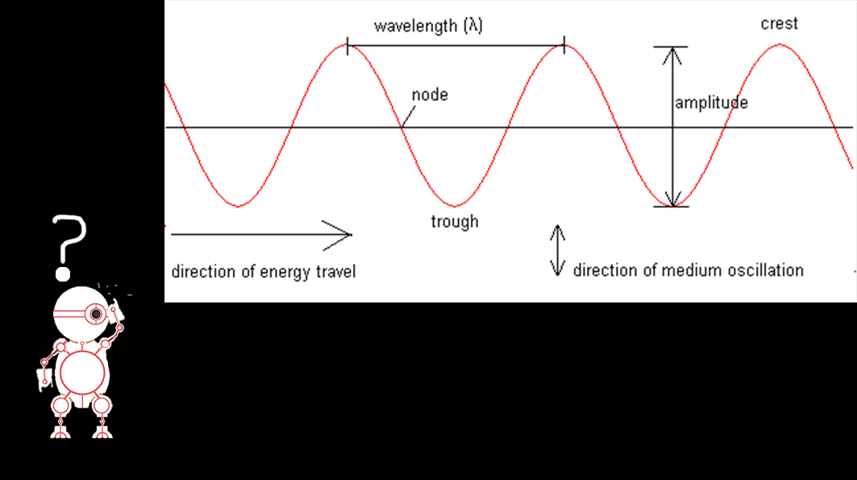
Wave Generation
Sine waves – who knew?
I mean, without them we wouldn’t be having this fascinating presentation….

Slide 10
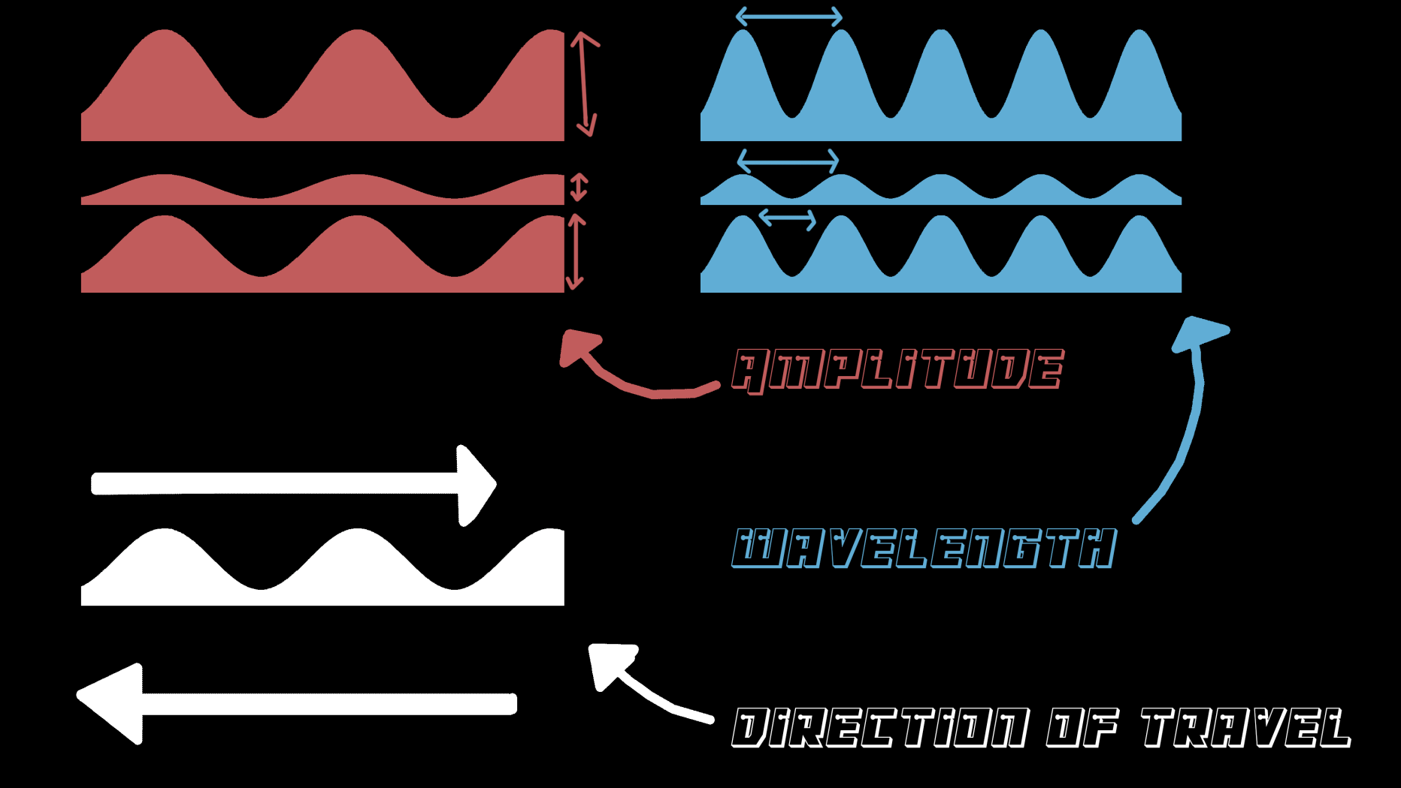
Wave Optimisation
From wonderful, wonderful bugs/glitches, to the implications of wave amplitude on the trajectory of the ball bounce.

Slide 11

There Can Only Be One
Adversarial: one user attempting to score 4 goals to win.

Slide 12
What Makes This Game So Special?
USP: The game takes a tried and tested formula for multiplayer and builds on it by making the terrain an additional adversary.

Slide 13
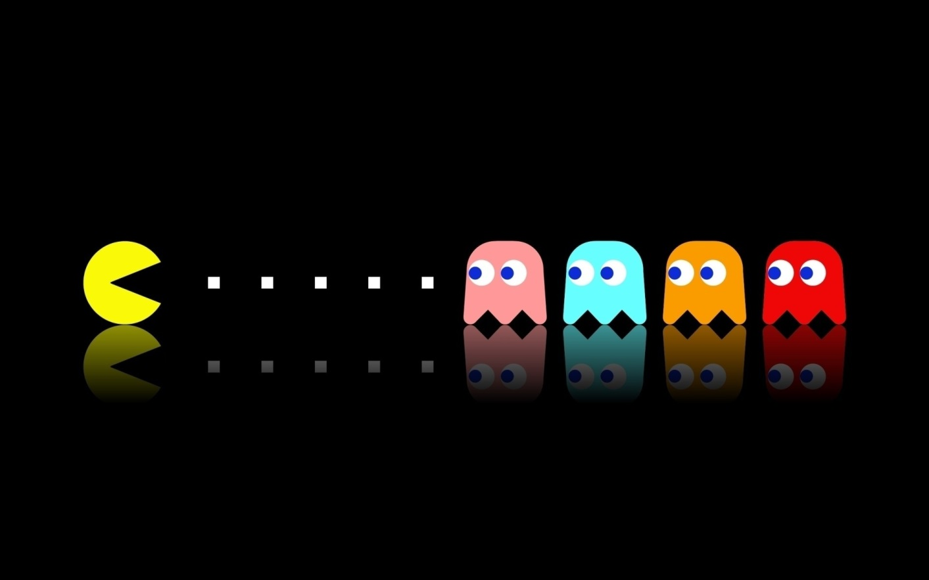
Keeping It Simple
Art style, game play, UI.
Make the game as accessible as possible.

Slide 14
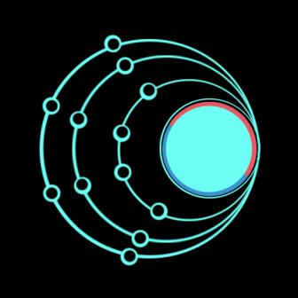


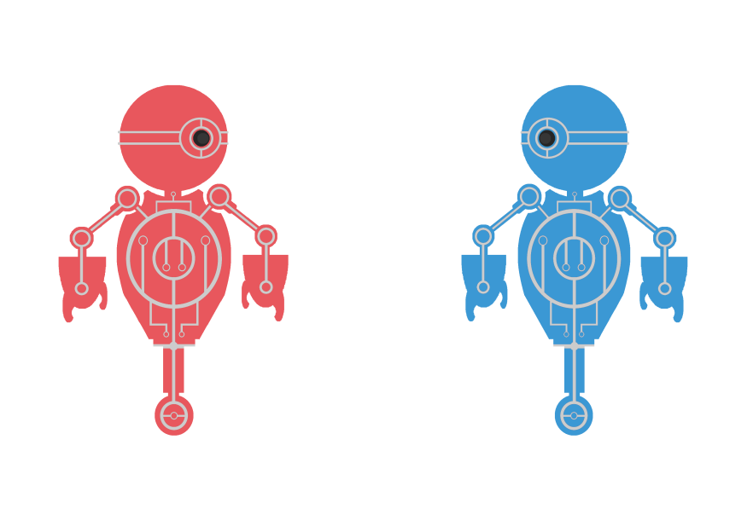
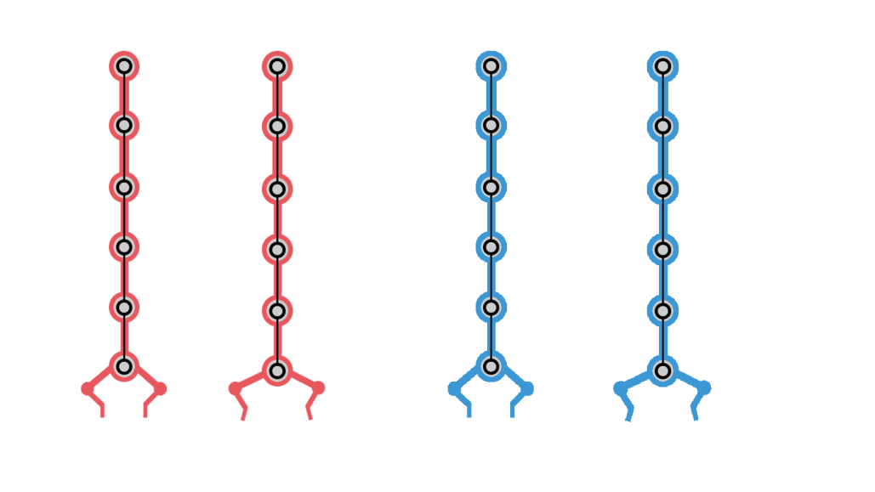
The Art
Kept simple by using a consistent split-complimentary colour harmony (red, blue and green).

Slide 15



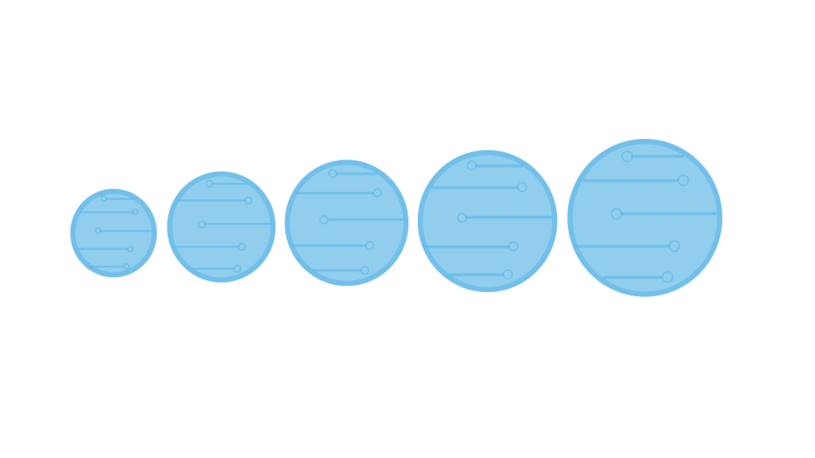
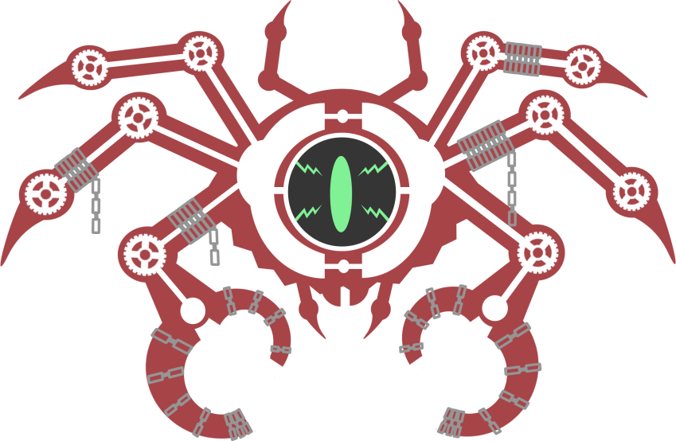
Theme
Theme is using a mechanical vector style.

Slide 16
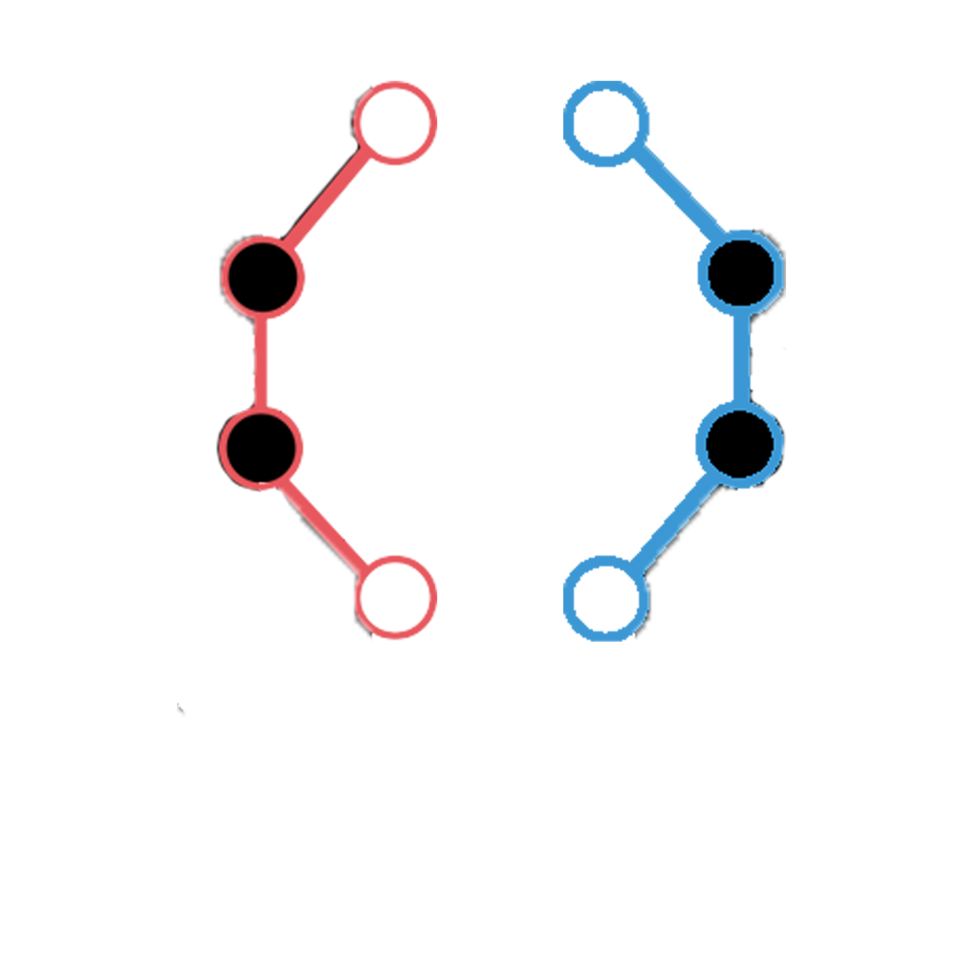

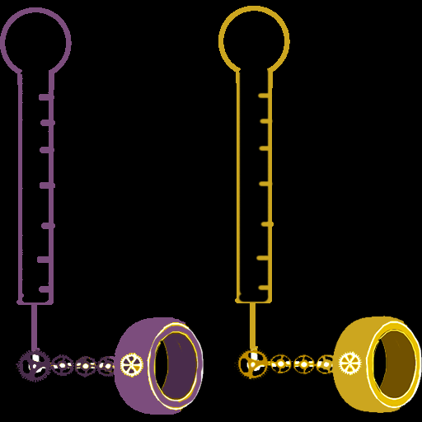
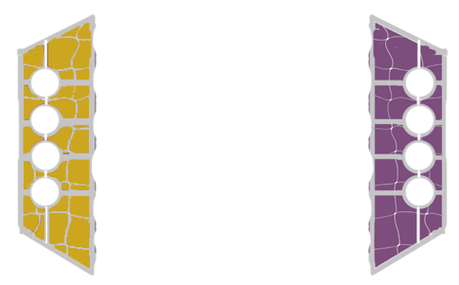
More Art…
It still uses a mechanical vector style (with sharp lines and circles as detail).

Slide 17
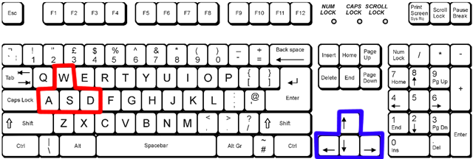
Game Play
Both players use a keyboard to control their character

Slide 18
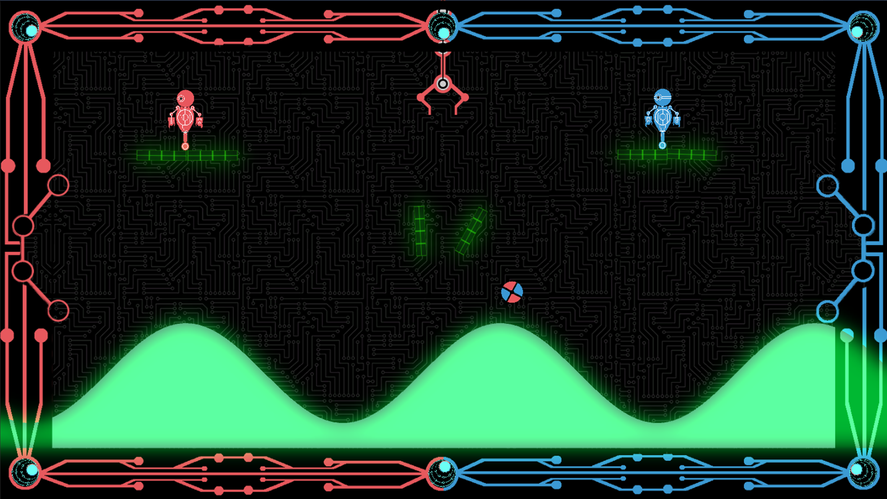
Game Play Pt 2
Represent the objective as plainly as possible

Slide 19
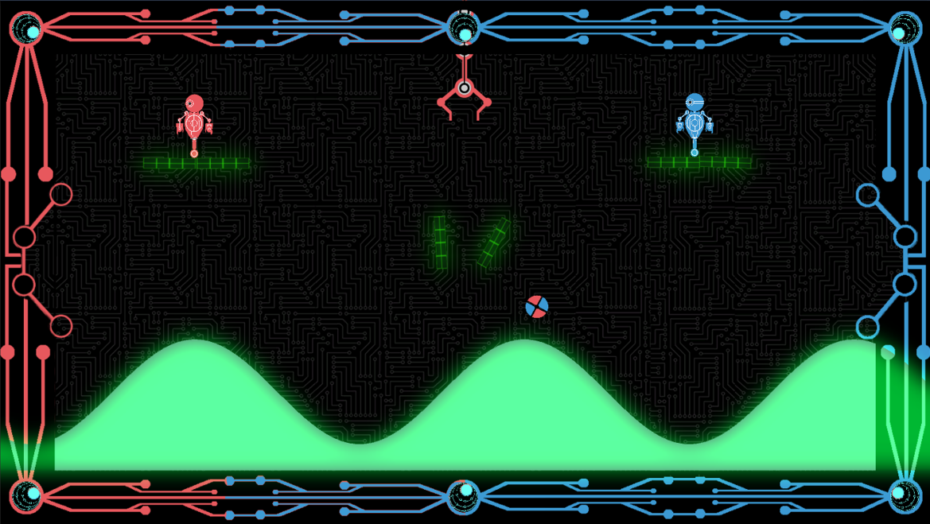
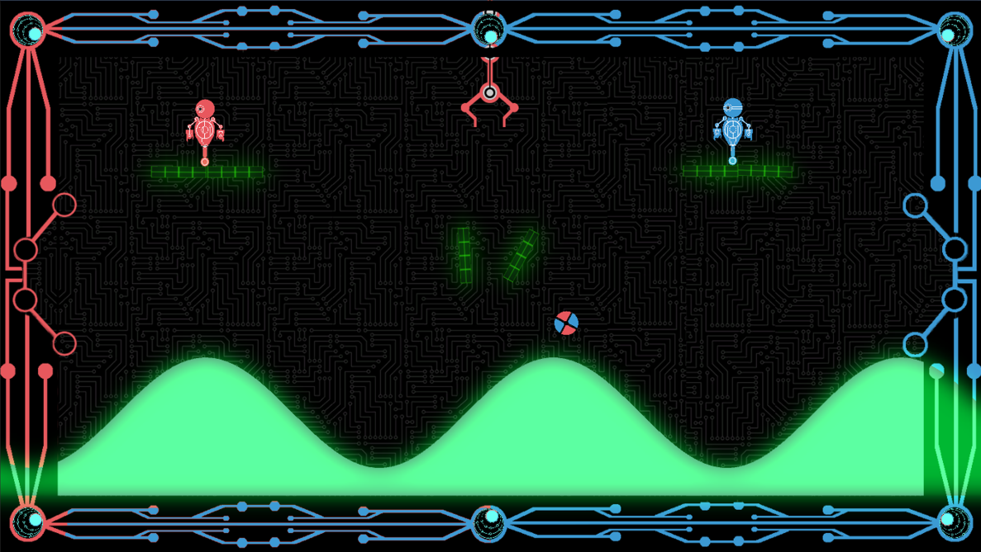
UI
Tug of war style scoring system that uses the foreground and a slider to display the score.

Slide 20
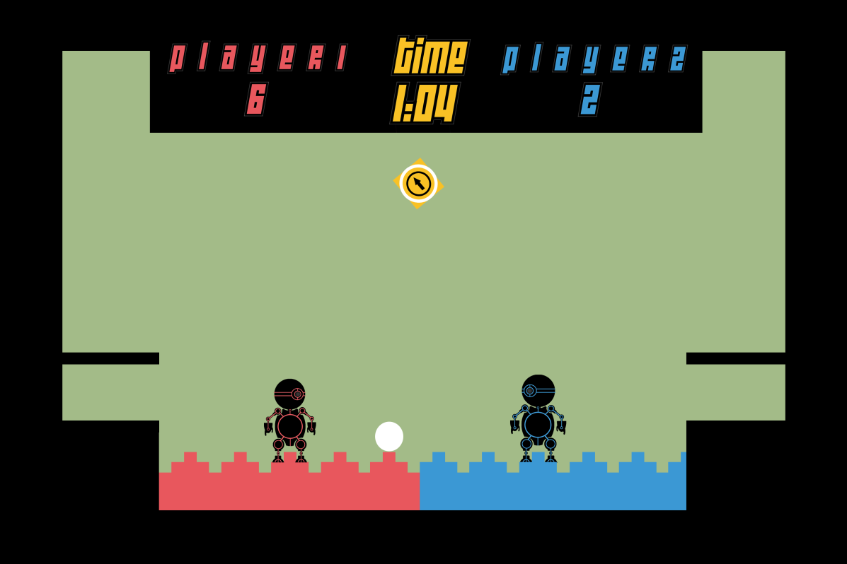
UI
Back to basics with a numerical score display.
But retained the principle of the foreground responding to the score.

Slide 21

But why am I here?
Said the play tester to the game design student…

Slide 22
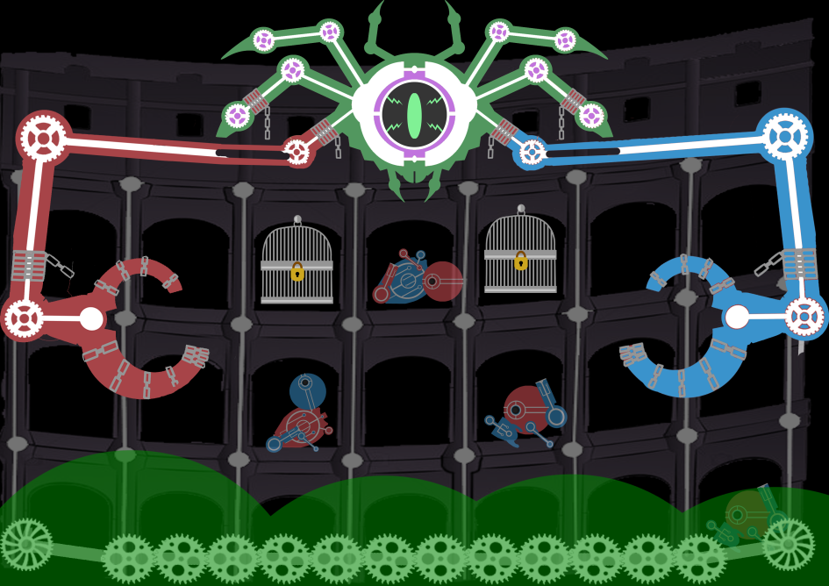
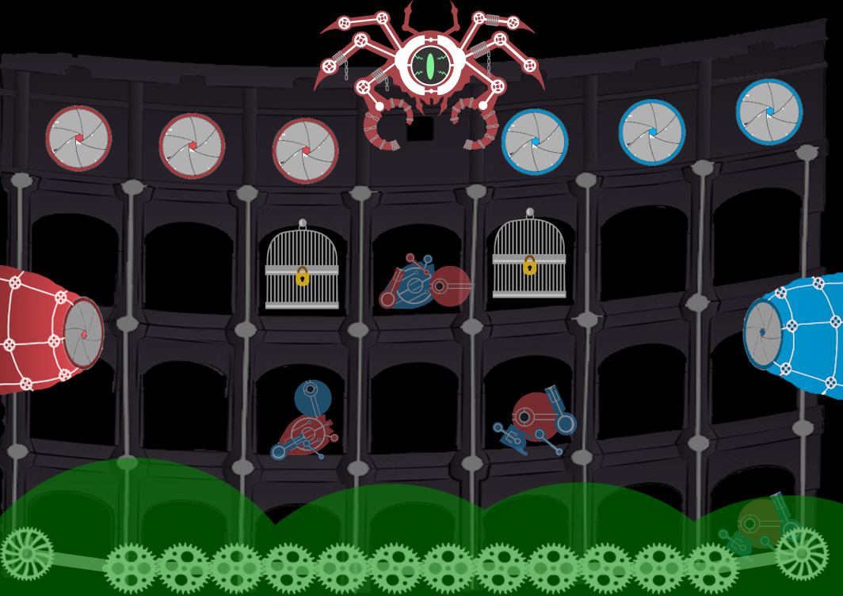
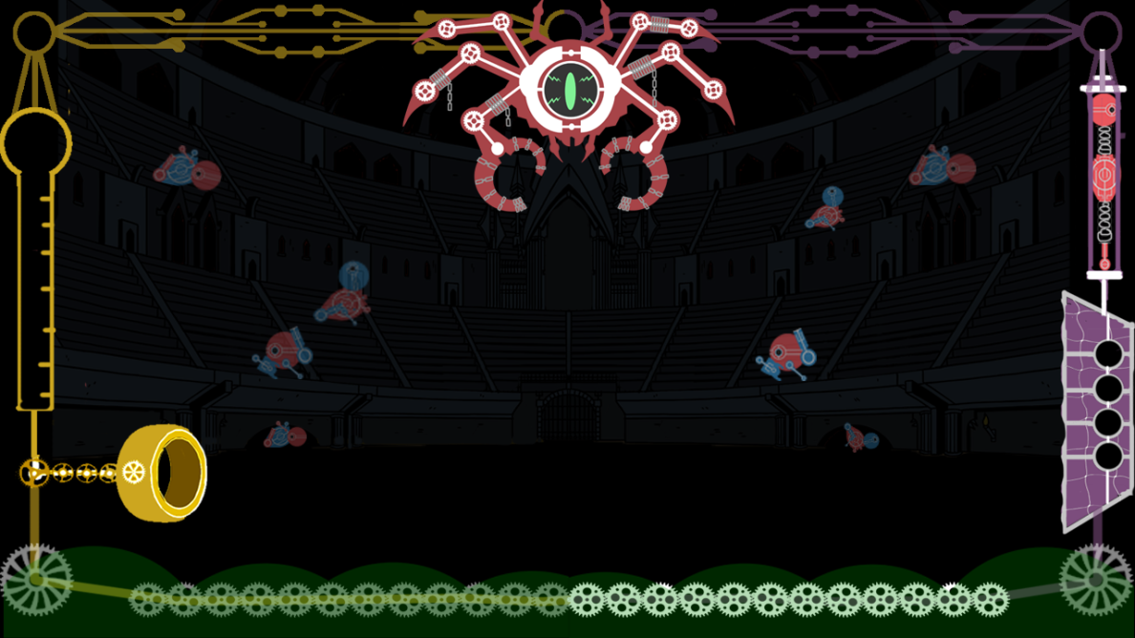
Current Player Feedback
What impression was being left on the players? Emergent gameplay?
Or just delusions of grandeur?

Slide 23
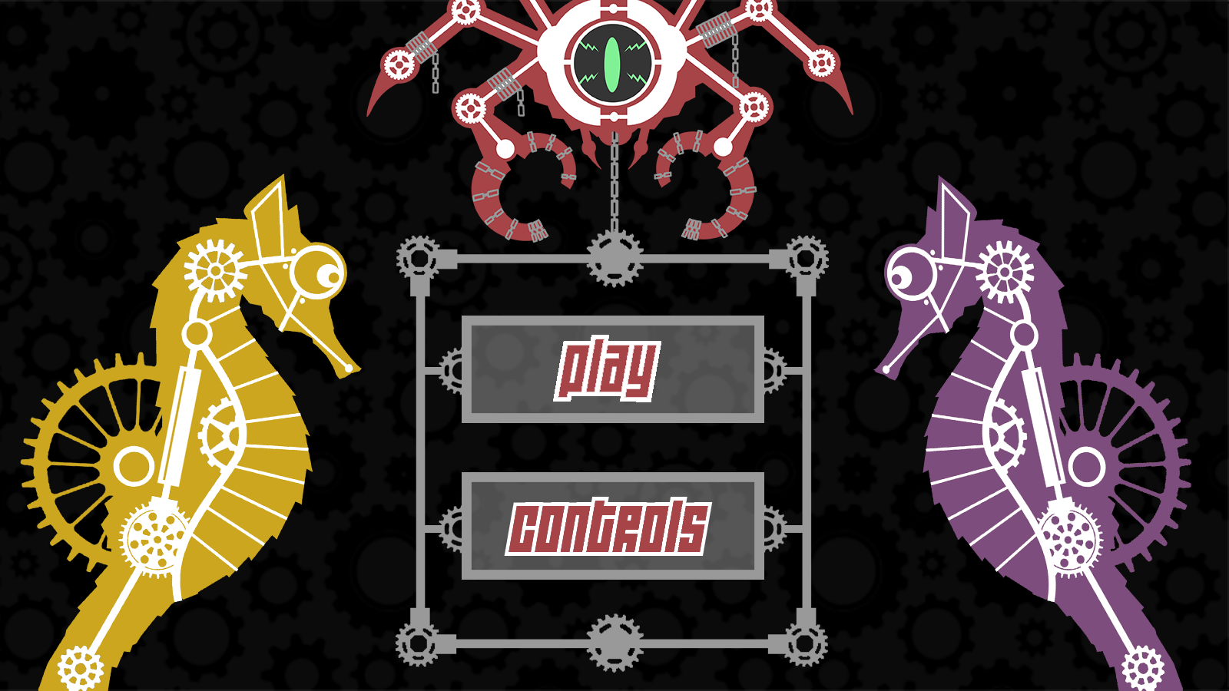
A Novel Approach
Bringing meaning to the visual narrative, and attempting to tell a story without words.

Slide 24
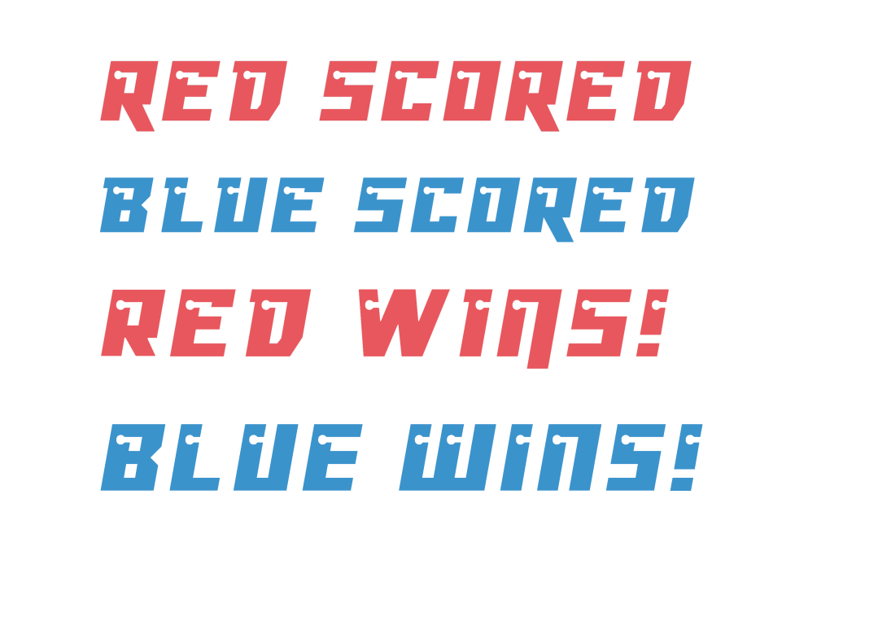
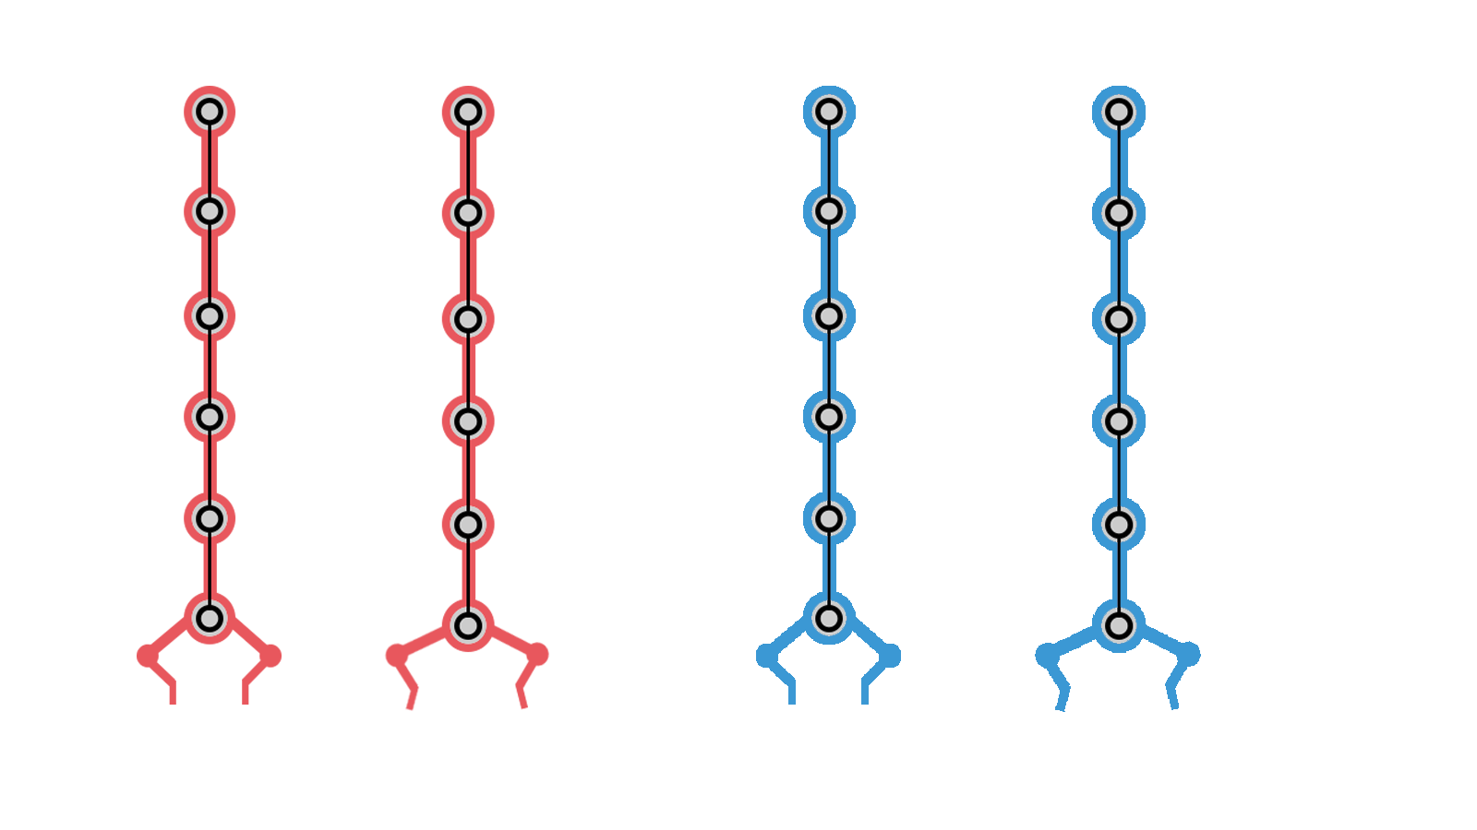
Visual Feedback
Popups.
Cam Shake
Explosions.
Ball explodes.
The foreground is part of
the UI.
Kick feedback

Slide 25
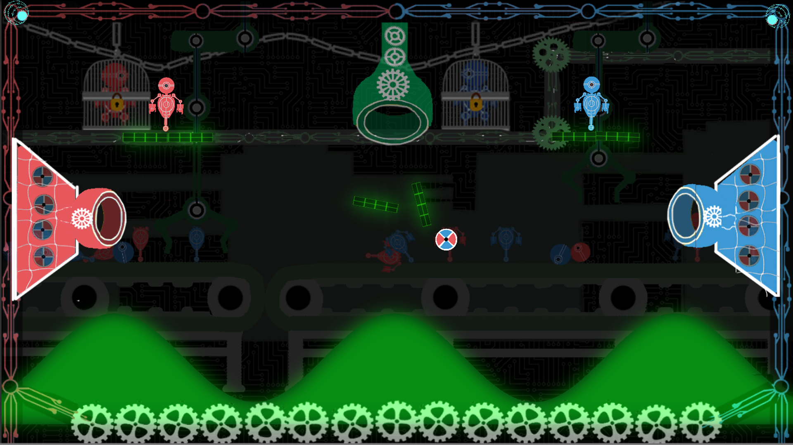
Final Iteration

Slide 26
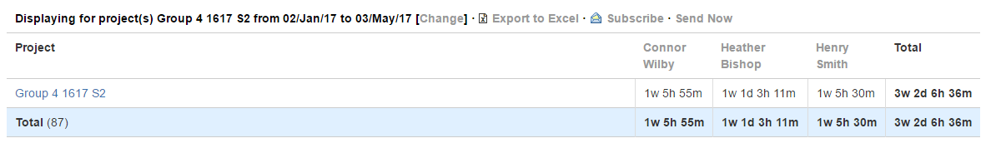
Project Information
Hours Logged
Emails Sent
Connor: 83
Henry:36
Sam: 2
Heather: 84

Slide 27
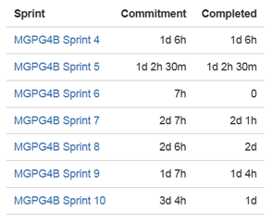
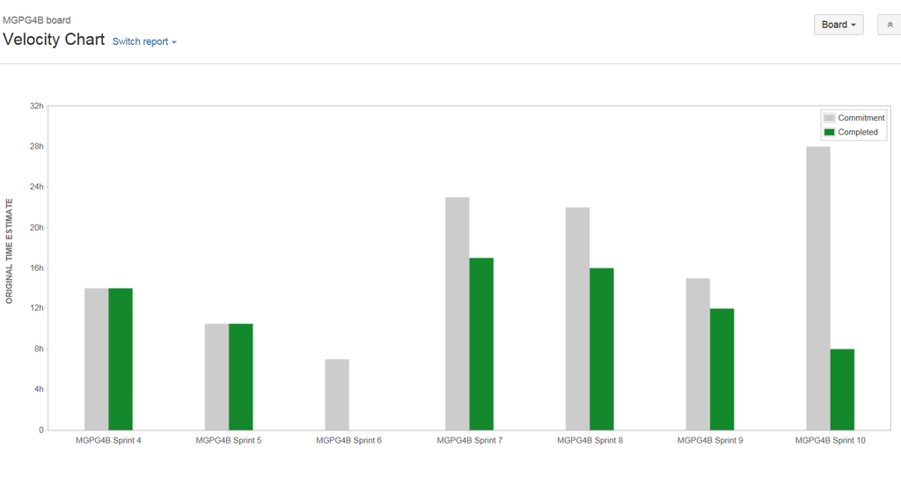
Sprint Breakdown

Slide 28

Questions?

